Slide 1





MAMC01901 Business Analysis
Week 6 (Session 1): Business analysis techniques (Process Modelling)

Slide 2



Agenda
Process models
Class activity
Assessment 2

Slide 3




View of an organisation
A collection of people
A collection of data and information
A collection of products and services
A collection of business processes – how work is performed

Slide 4
Business Process Modelling
What is a process?
A series of connected steps, actions, and decisions involving people and things, which work together to achieve a specific business goal.
Examples of Processes:
Order Fulfillment in retail
Patient Admission in healthcare
Loan Approval in banking
On boarding in HR
Processes are everywhere!

Slide 5
Business Process Modelling
What is a process management?
Process Management involves designing, executing, monitoring, and optimising business processes to improve efficiency, effectiveness, and adaptability.
Why is process management important?
Streamline operations
Eliminate waste
Improve customer satisfaction
Align processes with business strategy

Slide 6
Process Management Cycle
Identify the process
Model the current state (As-Is)
Analyse performance and bottlenecks
Design improvements (To-Be)
Implement changes
Monitor and Control performance
Refine continuously

Slide 7
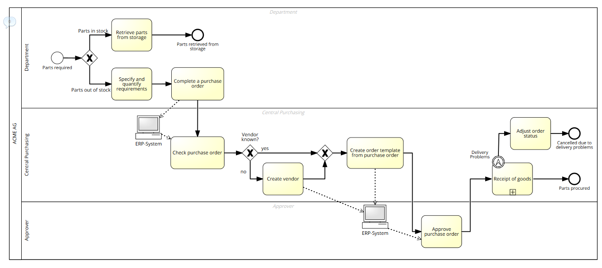
Example

Slide 8
The core elements of a process
Things that initiate a process
A unit of work, time consuming, resource-demanding
Points in time when a decision is made that affects the way the process is executed
Internal or external actors; can be humans or systems
The execution of a process leads to one or several outcomes including positive or negative outcomes
Start Events
Activities
Decision points
Actors
End Events/ Outcomes

Slide 9

Start event
Initiates a process case
First element of a process model
Element in Signavio-
Naming convention- noun + verb in past tense
Example- for an online shopping process for Amazon, start event would be ‘order received’

Slide 10

End Event
Marks the end of a process case
Last element of a process model
Element in Signavio-
Naming convention- noun + verb in past participle
Example- for an online shopping process at Amazon, end event would be ‘order sent’

Slide 11

Tasks
Represents individual activities within a process
Element in Signavio-
Naming convention- always needs to start with verb in its present form (action words)
Examples- store data, create purchase order, check for completeness

Slide 12
Sequence flow
Solid arrow used to connect elements of a process model
Element in Signavio-
All elements (events, gateways and tasks) need to be connected using the sequence flow
A process model always flows from left to right. Therefore, the arrowhead always needs to point to the right

Slide 13







Exclusive (XOR) gateway
Used when “either/or” decisions have to be made in the process
Element in Signavio-
Example 1-
In the above example, there are 2 possible endings, but there can only be 1 actual ending depending on the decision made
Compulsory to label the branches

Slide 14

Lanes
Pool
Represents the organisation
Represents departments or individual roles (belonging to the organisation) responsible for doing something in a process
Identifies which task is performed by who
Modelled within the pool

Slide 15
Example
University Course Enrollment Process
Actor: Student
Start event: Enrolment required
Activities:
Log into portal
View available courses
Select and enroll
Receive confirmation email
End event: Enrolment completed

Slide 16
BuildIT equipment rental process
A site engineer needs new equipment so the site engineer submits an equipment rental request to the clerk. The clerk then proceeds with selecting suitable equipment followed by checking the equipment’s availability. If the equipment is not available, the clerk has to go through the selection suitable equipment again and repeats the equipment availability check. If the equipment is available, the works engineer reviews the rental request. If the rental request is approved, the clerk creates a purchase order and the process ends. If the rental request is rejected, the process also ends with request being rejected.

Slide 17
BuildIT equipment rental process
Actor | Activity/Event/Decision point

Slide 18
Class Activity
Read the HR on boarding process provided (on teams, under ‘class activities’ folder).
Identify the actors, start and end events, and activities.
Based on the description, model the as-is process.
Identify the issues with the current process
Propose solutions to improve the current process.
.

Slide 19
Assessment 2
Critically evaluate the role of a business analyst in the chosen organisation.
Critically analyse at least two contemporary organisational issues that the organisation may face or is currently facing.
Critically apply at least two business analysis techniques to evaluate the issues faced by the organisation.
Propose and critically justify the alignment of solutions to the issues with the organisation’s strategic goals.
.

